Slide 1
VPN with IPsec
Project 2
Group 7
Anastasia Safargalieva & Soumya Lekkala
Prof. Tuomas Aura

Slide 2
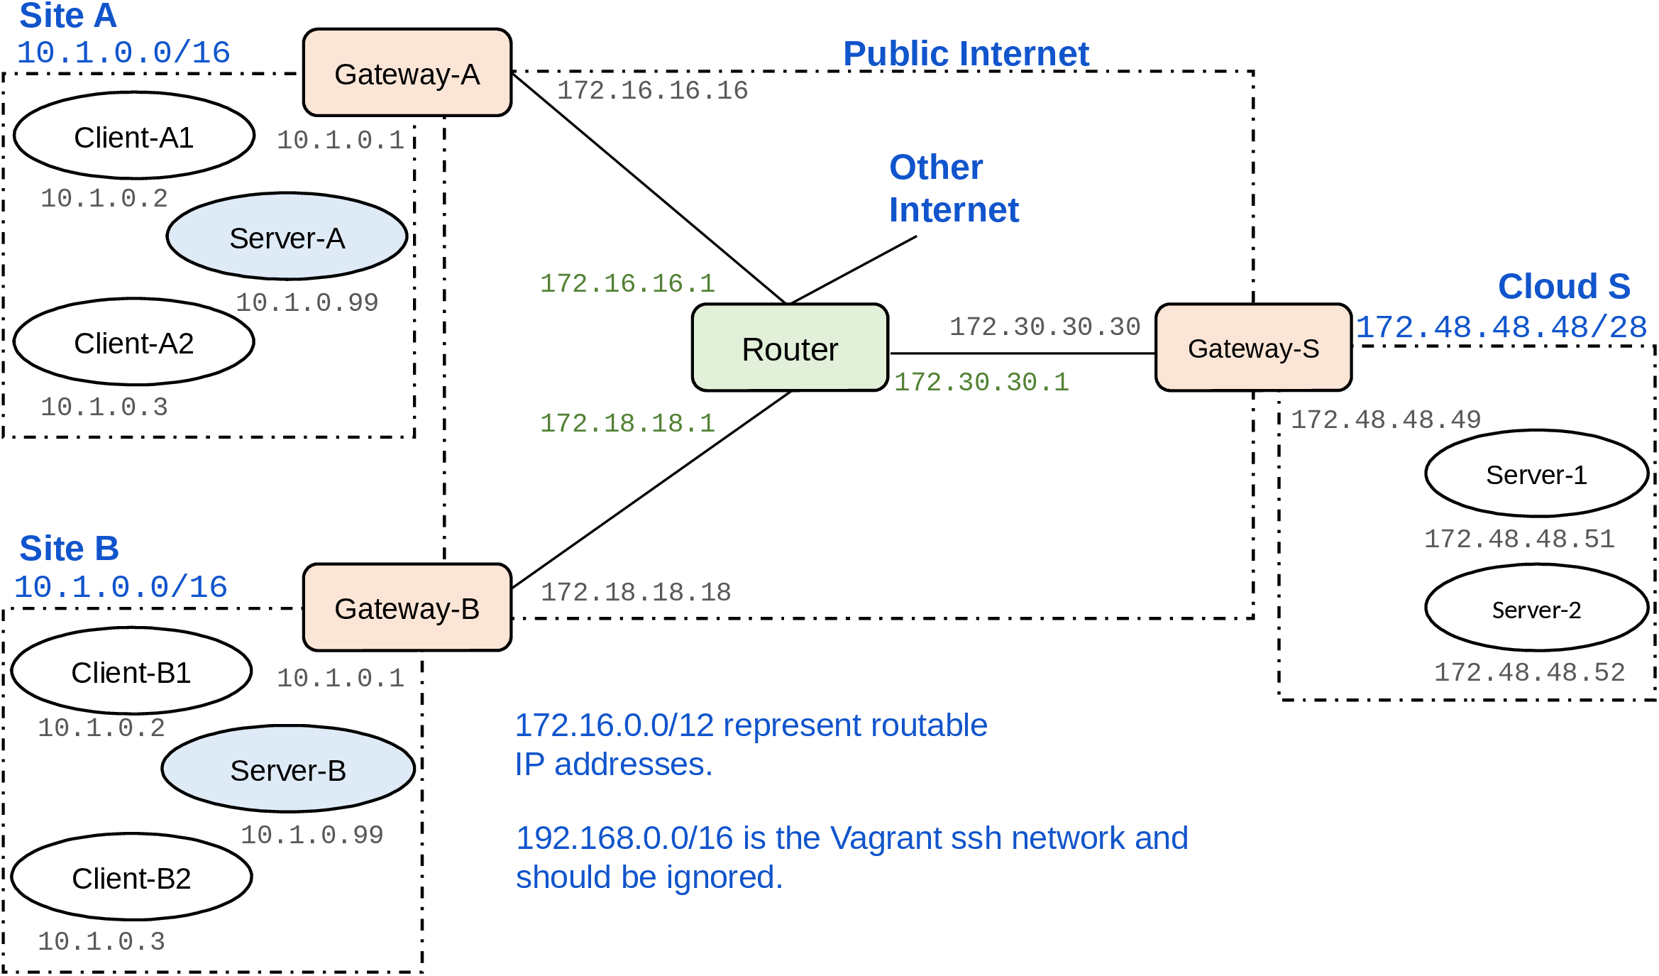
Current topology

Slide 3
New topology
10.1.0.1
10.1.0.2
10.1.0.3

Slide 4
Changes
Cloud S is now private (10.1.0.1)
Server A and Server B moved to the cloud S
Gateways A and B work as servers now sending the packets to the cloud
According to IPsec configuration, gateways are the endpoints
DNAT implemented

Slide 5
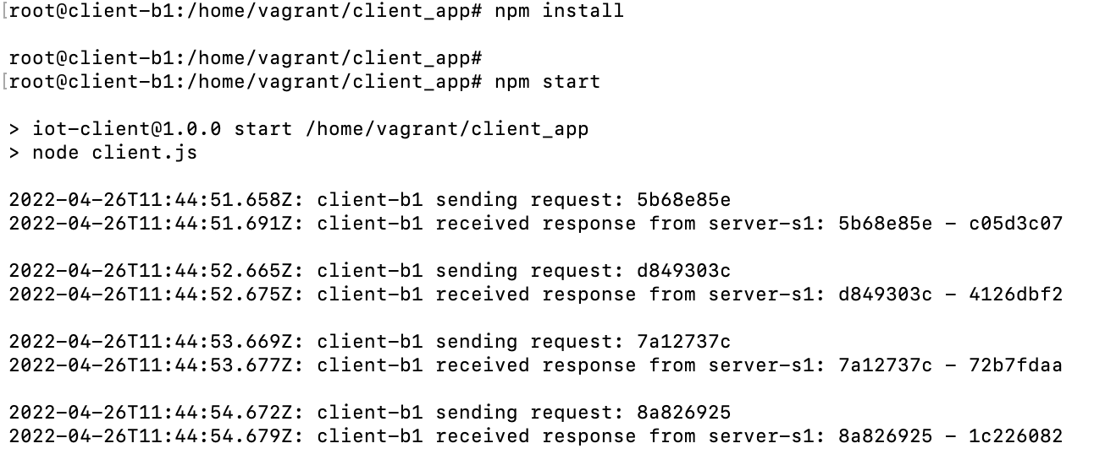
Properties of the new setup
The VPN is based on the Encapsulating Security Payload (ESP) protocol
StrongSwan is included

